Slide 1
COBIT 5
Presented by
ISACA

Slide 2
Introduction to COBIT
COBIT (Control Objectives for Information and Related Technologies) is a good-practice framework created by international professional association ISACA for information technology (IT) management and IT governance.
COBIT provides an implementable "set of controls over information technology and organizes them around a logical framework of IT-related processes and enablers."

Slide 3
COBIT 5 Implementation
Presented by
Emilio Gratton
ISACA Member n. 630629

Slide 4
OUTLINE
COBIT 5
THE FRAMEWORK (A BIT OF HISTORY)
PRINCIPLES
ENABLING PROCESSES
COVERAGE
IMPLEMENTATION APPROACH
2. WAY-AHEAD

Slide 5
COBIT 5: THE FRAMEWORK

Slide 6
COBIT 5: Now One Complete Business Framework for
Governance of Enterprise IT
Evolution of scope
IT Governance
Val IT 2.0
(2008)
Management
Control
Risk IT
(2009)
Audit
COBIT1
COBIT2
COBIT3
COBIT4.0/4.1
COBIT 5
1996
1998
2000
2005/7
2012
An business framework from ISACA, at www.isaca.org/cobit
© 2012 ISACA® All rights reserved.

Slide 7
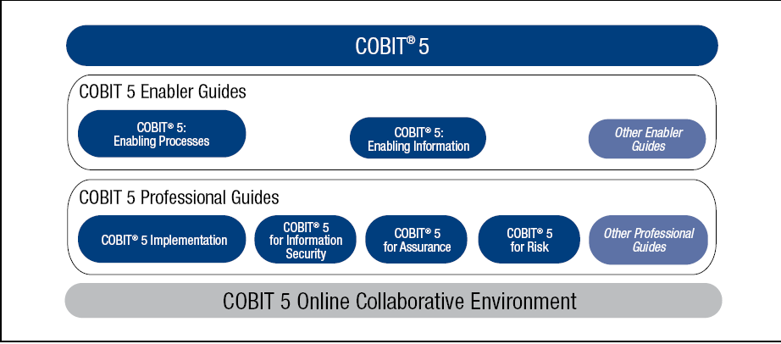
COBIT 5 Product Family and
framework
Source: COBIT® 5, figure 11. © 2012 ISACA® All rights reserved.
Notes:
COBIT 5:
The main, overarching COBIT 5 product
Contains the executive summary and the full description of all of the COBIT 5 framework components:
The five COBIT 5 principles
The seven COBIT 5 enablers plus
An introduction to the implementation guidance provided by ISACA (COBIT 5 Implementation)
An introduction to the COBIT Assessment Programme (not specific to COBIT 5) and the process capability approach being adopted by ISACA for COBIT
Future supporting products:
Professional Guides:
COBIT 5 for Information Security
COBIT 5 for Assurance
COBIT 5 for Risk
Enabler Guides:
COBIT 5: Enabling Information
COBIT Online Replacement
COBIT Assessment Programme:
Process Assessment Model (PAM): Using COBIT 5
Assessor Guide: Using COBIT 5
Self-assessment Guide: Using COBIT 5

Slide 8
COBIT 5: THE PRINCIPLES

Slide 9
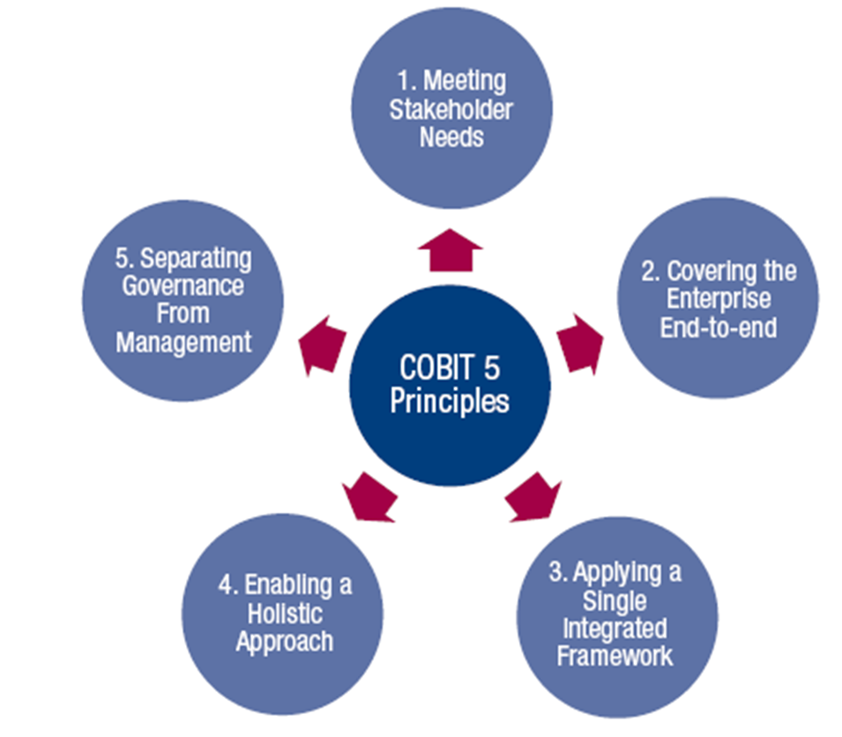
The Five COBIT 5 Principles
ISO 38500 principles:
RESPONSABILITY
STRATEGY
ACQUISITION
PERFORMANCE
CONFORMANCE
HUMAN BEHAVIOUR
Notes:
ISO 38500 principles mapping

Slide 10
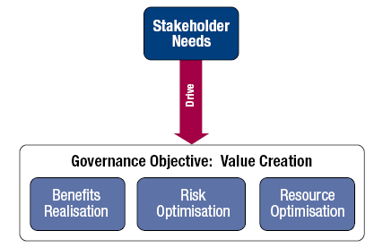
1. Meeting Stakeholder Needs
Principle 1. Meeting Stakeholder Needs
Enterprises exist to create value for their stakeholders.
Source: COBIT® 5, figure 3. © 2012 ISACA® All rights reserved.
Notes:
Principle 1. Meeting Stakeholder Needs:
Enterprises have many stakeholders, and ‘creating value’ means different—and sometimes conflicting—things to each of them.
Governance is about negotiating and deciding amongst different stakeholders’ value interests.
The governance system should consider all stakeholders when making benefit, resource and risk assessment decisions.
For each decision, the following can and should be asked:
Who receives the benefits?
Who bears the risk?
What resources are required

Slide 11
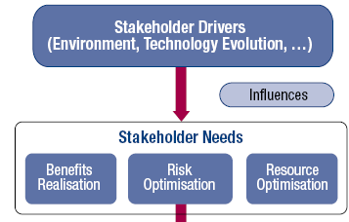
1. Meeting Stakeholder Needs (cont.)
Principle 1. Meeting Stakeholder Needs:
Stakeholder needs have to be transformed into an enterprise’s actionable strategy.
The COBIT 5 goals cascade translates stakeholder needs into specific, actionable and customised goals within the context of the enterprise, IT-related goals and enabler goals.
Cascades to
Enterprise Goals
Cascades to
IT-related Goals
Cascades to
Enabler Goals
Source: COBIT® 5, figure 4. © 2012 ISACA® All rights reserved.
Notes:
Principle 1. Meeting Stakeholder Needs:
Stakeholder needs have to be transformed into an enterprise’s actionable strategy.
The COBIT 5 goals cascade translates stakeholder needs into specific, actionable and customised goals within the context of the enterprise, IT-related goals and enabler goals.
Benefits of the COBIT 5 goals cascade:
It allows the definition of priorities for implementation, improvement and assurance of enterprise governance of IT based on (strategic) objectives of the enterprise and the related risk.
In practice, the goals cascade:
Defines relevant and tangible goals and objectives at various levels of responsibility.
Filters the knowledge base of COBIT 5, based on enterprise goals to extract relevant guidance for inclusion in specific implementation, improvement or assurance projects.
Clearly identifies and communicates how (sometimes very operational) enablers are important to achieve enterprise goals.

Slide 12
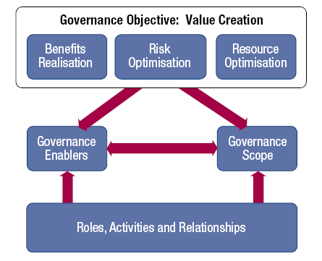
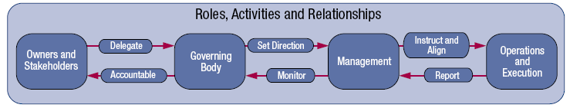
2. Covering the Enterprise End-to-end
Key components of a governance system
Notes:
Principle 2. Covering the Enterprise End-to-end:
COBIT 5 addresses the governance and management of information and related technology from an enterprise wide, end-to-end perspective.
This means that COBIT 5:
Integrates governance of enterprise IT into enterprise governance, i.e., the governance system for enterprise IT proposed by COBIT 5 integrates seamlessly in any governance system because COBIT 5 aligns with the latest views on governance.
Covers all functions and processes within the enterprise; COBIT 5 does not focus only on the ‘IT function’, but treats information and related technologies as assets that need to be dealt with just like any other asset by everyone in the enterprise

Slide 13
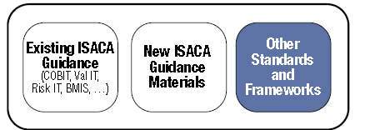
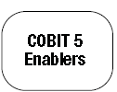

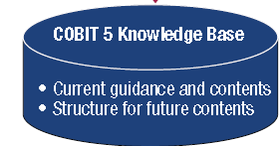
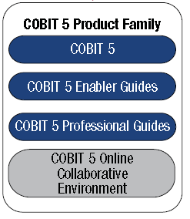


3. Applying a Single Integrated Framework
.
Notes:
Principle 3. Applying a Single Integrated Framework:
COBIT 5 aligns with the latest relevant other standards and frameworks used by enterprises:
Enterprise: COSO, COSO ERM, ISO/IEC 9000, ISO/IEC 31000
IT-related: ISO/IEC 38500, ITIL, ISO/IEC 27000 series, TOGAF, PMBOK/PRINCE2, CMMI
Etc.
This allows the enterprise to use COBIT 5 as the overarching governance and management framework integrator.
ISACA plans a capability to facilitate COBIT user mapping of practices and activities to third-party references

Slide 14
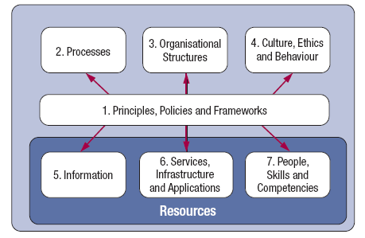
4. Enabling a Holistic Approach (cont.)
Principle 4. Enabling a Holistic Approach
Source: COBIT® 5, figure 12. © 2012 ISACA® All rights reserved.
Notes:
Principle 4. Enabling a Holistic Approach
COBIT 5 enablers are:
Factors that, individually and collectively, influence whether something will work—in the case of COBIT, governance and management over enterprise IT
Driven by the goals cascade, i.e., higher-level IT-related goals define what the different enablers should achieve
Described by the COBIT 5 framework in seven categories
Processes—Describe an organised set of practices and activities to achieve certain objectives and produce a set of outputs in support of achieving overall IT-related goals
Organisational structures—Are the key decision-making entities in an organisation
Culture, ethics and behaviour—Of individuals and of the organisation; very often underestimated as a success factor in governance and management activities
Principles, policies and frameworks—Are the vehicles to translate the desired behaviour into practical guidance for day-to-day management
Information—Is pervasive throughout any organisation, i.e., deals with all information produced and used by the enterprise. Information is required for keeping the organisation running and well governed, but at the operational level, information is very often the key product of the enterprise itself.
Services, infrastructure and applications—Include the infrastructure, technology and applications that provide the enterprise with information technology processing and services
People, skills and competencies—Are linked to people and are required for successful completion of all activities and for making correct decisions and taking corrective actions
Systemic governance and management through interconnected enablers—To achieve the main objectives of the enterprise, it must always consider an interconnected set of enablers, i.e., each enabler:
Needs the input of other enablers to be fully effective, e.g., processes need information, organisational structures need skills and behaviour
Delivers output to the benefit of other enablers, e.g., processes deliver information, skills and behaviour make processes efficient
This is a KEY principle emerging from the ISACA development work around the Business Model for Information Security (BMIS).

Slide 15
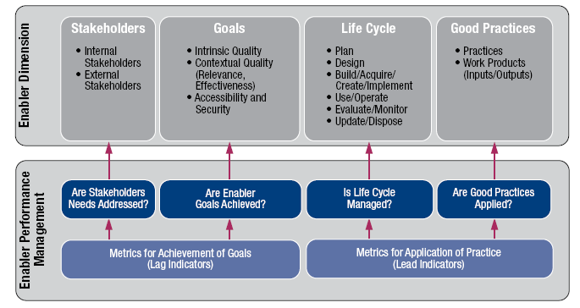
4. Enabling a Holistic Approach (cont).
COBIT 5 Enabler Dimensions:
Source: COBIT® 5, figure 13. © 2012 ISACA® All rights reserved.
Notes:
All enablers have a set of common dimensions. This set of common dimensions:
Provides a common, simple and structured way to deal with enablers
Allows an entity to manage its complex interactions
Facilitates successful outcomes of the enablers

Slide 16
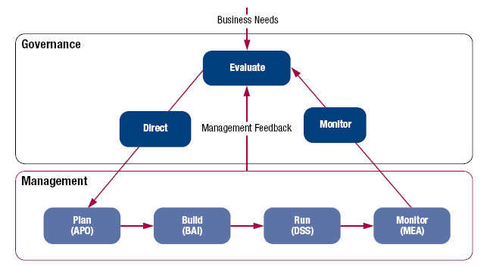
5. Separating Governance From Management (cont.)
Principle 5. Separating Governance From Management:
COBIT 5 is not prescriptive, but it advocates that organisations implement governance and management processes such that the key areas are covered, as shown.
Source: COBIT® 5, figure 15. © 2012 ISACA® All rights reserved.
Notes:
Principle 5. Separating Governance From Management:
The COBIT 5 framework makes a clear distinction between governance and management.
These two disciplines:
Encompass different types of activities
Require different organisational structures
Serve different purposes
Governance—In most enterprises, governance is the responsibility of the board of directors under the leadership of the chairperson.
Management—In most enterprises, management is the responsibility of the executive management under the leadership of the CEO.
Governance ensures that stakeholders needs, conditions and options are evaluated to determine balanced, agreed-on enterprise objectives to be achieved; setting direction through prioritisation and decision making; and monitoring performance and compliance against agreed-on direction and objectives (EDM).
Management plans, builds, runs and monitors activities in alignment with the direction set by the governance body to achieve the enterprise objectives (PBRM).
The COBIT 5 framework describes seven categories of enablers (Principle 4). Processes are one category.
An enterprise can organise its processes as it sees fit, as long as all necessary governance and management objectives are covered. Smaller enterprises may have fewer processes; larger and more complex enterprises may have many processes, all to cover the same objectives.
COBIT 5 includes a process reference model (PRM), which defines and describes in detail a number of governance and management processes. The details of this specific enabler model can be found in the COBIT 5: Enabling Processes volume.

Slide 17
COBIT 5: ENABLING PROCESSES

Slide 18
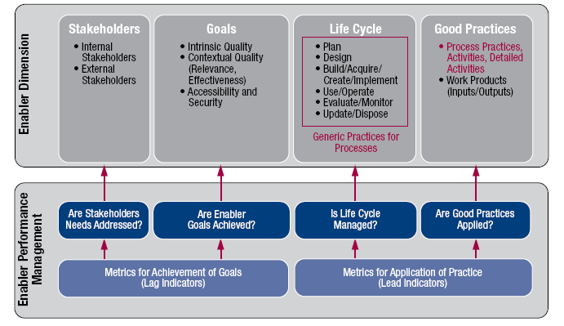
COBIT 5: Enabling Processes
Source: COBIT® 5, figure 29. © 2012 ISACA® All rights reserved.
Notes:
COBIT 5: Enabling Processes complements COBIT 5 and contains a detailed reference guide to the processes that are defined in the COBIT 5 process reference model:
In Chapter 2, the COBIT 5 goals cascade is recapitulated and complemented with a set of example metrics for the enterprise goals and the IT-related goals.
In Chapter 3, the COBIT 5 process model is explained and its components defined.
Chapter 4 shows the diagram of this process reference model.
Chapter 5 contains the detailed process information for all 37 COBIT 5 processes in the process reference model.

Slide 19
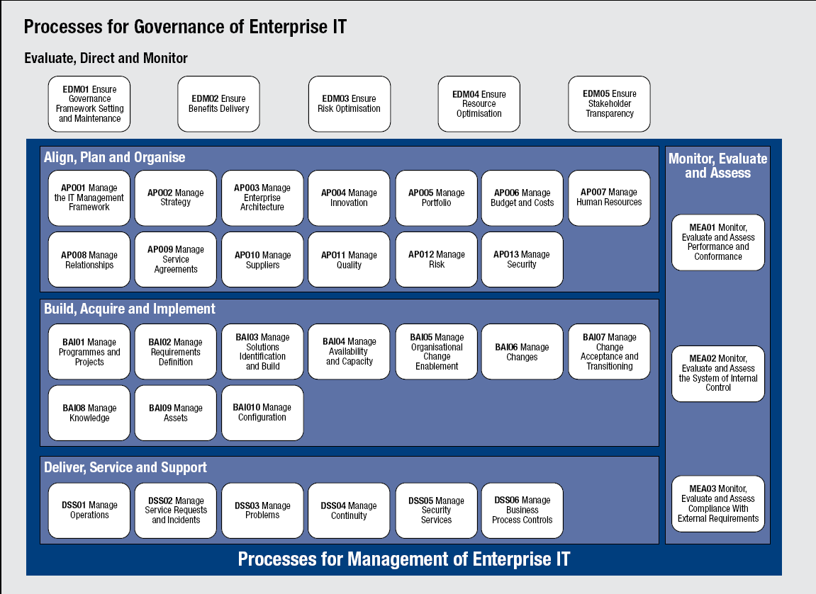
COBIT 5: Enabling Processes (cont.)
Notes:
COBIT 5: Enabling Processes:
The COBIT 5 process reference model subdivides the IT-related practices and activities of the enterprise into two main areas—governance and management— with management further divided into domains of processes:
The GOVERNANCE domain contains five governance processes; within each process, evaluate, direct and monitor (EDM) practices are defined.
The four MANAGEMENT domains are in line with the responsibility areas of plan, build, run and monitor (PBRM).

Slide 20
COBIT 5: COVERAGE

Slide 21
COBIT 5: COVERAGE
Evaluate, Direct and Monitor
ISO/IEC 31000
ISO/IEC 38500
Align, Plan and Organise
Monitor, Evaluate and Asses
ISO/IEC 27000
TOGAF
PRINCE2/PMBOK
CMMI
Build Acquire and Implement
ITIL V3 2011 AND ISO/IEC 20000
Delivery Service and Support

Slide 22
COBIT 5 Implementation

Slide 23
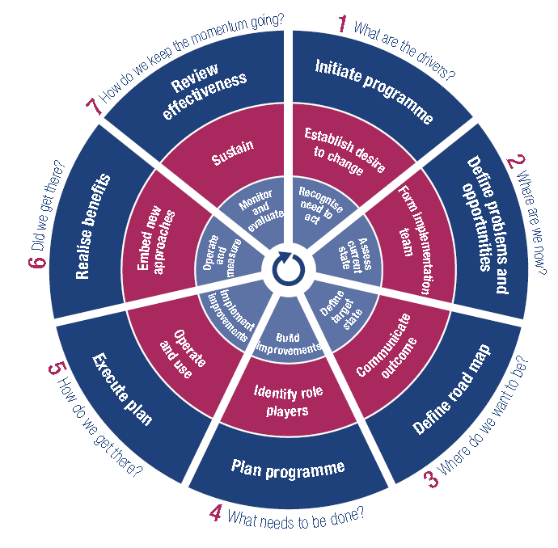
COBIT 5 Implementation
PROFESSIONAL GUIDE
FOR A LIFE CYCLE
PROGRAMME
Programme management
(outer ring)
Change enablement
(middle ring)
Continual improvement Life Cycle
(inner ring)
Notes:
The improvement of the governance of enterprise IT (GEIT) is widely recognised by top management as an essential part of enterprise governance.
Information and the pervasiveness of information technology are increasingly part of every aspect of business and public life.
The need to drive more value from IT investments and manage an increasing array of IT-related risk has never been greater.
Increasing regulation and legislation over business use of information is also driving heightened awareness of the importance of a well-governed and managed IT environment.
ISACA has developed the COBIT 5 framework to help enterprises implement sound governance enablers. Indeed, implementing good GEIT is almost impossible without engaging an effective governance framework. Best practices and standards are also available to underpin COBIT 5.
Frameworks, best practices and standards are useful only if they are adopted and adapted effectively. There are challenges that need to be overcome and issues that need to be addressed if GEIT is to be implemented successfully.
COBIT 5: Implementation provides guidance on how to do this.
COBIT 5: Implementation covers the following subjects:
Positioning GEIT within an enterprise
Taking the first steps towards improving GEIT
Implementation challenges and success factors
Enabling GEIT-related organisational and behavioural change
Implementing continual improvement that includes change enablement and programme management
Using COBIT 5 and its components

Slide 24
1ST STEP: CREATING THE APPROPRIATE ENVIRONMENT
ROLES
BOARD & EXECUTIVES | Set direction for the programme, ensure alignment with enterprisewide governance and risk management, approve key programme roles and define responsibilities, and give visible support and commitment. Sponsor, communicate and promote the agreed-on initiative.
Business management | Provide appropriate stakeholders and champions to drive commitment and to support the programme. Nominate key programme roles and define and assign responsibilities.
IT management | Ensure that the business and executives understand and appreciate the high-level IT-related issues and objectives. Nominate key programme roles and define and assign responsibilities. Nominate a person to drive the programme in agreement with the business
Internal audit | Agree on the role and reporting arrangements for audit participation. Ensure that an adequate level of audit participation is provided through the duration of the programme
Risk, compliance and legal | Ensure an adequate level of participation through the duration of the programme.

Slide 25
1ST STEP: CREATING THE APPROPRIATE ENVIRONMENT

Slide 26
WAY-AHEAD PROPOSAL

Slide 27
COBIT5 IMPLEMENTATION STEP-AHEAD
SPIRAL APPROACH TO ENLARGE
SCOPE
COVERAGE
TOOLS ADOPTIONS

Slide 28
COBIT5 IMPLEMENTATION STEP-AHEAD
SCOPE
CIO
endorse
Program Plan
Change Enablement
Continual Improvement Life Cycle

Slide 29
COBIT5 IMPLEMENTATION STEP-AHEAD
COVERAGE
Main Boards
Groups
Teams (single procedures)
Teams (matrix procedures)

Slide 30
COBIT5 IMPLEMENTATION STEP-AHEAD
TOOLS
Pilot Project
Test-bed or
Proof-of-concept
PMO aggregation
Enterprise Projects

Slide 31
COBIT 5 for Information Security Introduction
Presented by
ISACA

Slide 32
© 2012 ISACA. All rights reserved. No part of this publication may be used, copied, reproduced, modified, distributed, displayed, stored in a retrieval system or transmitted in any form by any means (electronic, mechanical, photocopying, recording or otherwise) without the prior written authorisation of ISACA. Use of this publication is permitted solely for personal use and must include full attribution of the material’s source. No other right or permission is granted with respect to this work.

Slide 33
Information!
Information is a key resource for all enterprises.
Information is created, used, retained, disclosed and destroyed.
Technology plays a key role in these actions.
Technology is becoming pervasive in all aspects of business and personal life.
What benefits do information and technology bring to enterprises?
© 2012 ISACA. All rights reserved. 33

Slide 34
Enterprise Benefits
Enterprises and their executives strive to:
Maintain quality information to support business decisions.
Generate business value from IT-enabled investments, i.e., achieve strategic goals and realise business benefits through effective and innovative use of IT.
Achieve operational excellence through reliable and efficient application of technology.
Maintain IT-related risk at an acceptable level.
Optimise the cost of IT services and technology.
How can these benefits be realised to create enterprise stakeholder value?
© 2012 ISACA. All rights reserved. 34

Slide 35
Stakeholder Value
Delivering enterprise stakeholder value requires good governance and management of information and technology (IT) assets.
Enterprise boards, executives and management have to embrace IT like any other significant part of the business.
External legal, regulatory and contractual compliance requirements related to enterprise use of information and technology are increasing, threatening value if breached.
COBIT 5 provides a comprehensive framework that assists enterprises to achieve their goals and deliver value through effective governance and management of enterprise IT.
© 2012 ISACA. All rights reserved. 35

Slide 36
The COBIT 5 Framework
Simply stated, COBIT 5 helps enterprises create optimal value from IT by maintaining a balance between realising benefits and optimising risk levels and resource use.
COBIT 5 enables information and related technology to be governed and managed in a holistic manner for the entire enterprise, taking in the full end-to-end business and functional areas of responsibility, considering the IT-related interests of internal and external stakeholders.
The COBIT 5 principles and enablers are generic and useful for enterprises of all sizes, whether commercial, not-for-profit or in the public sector.
© 2012 ISACA. All rights reserved. 36

Slide 37

COBIT 5 Principles
Source: COBIT® 5, figure 2. © 2012 ISACA® All rights reserved.
© 2012 ISACA. All rights reserved. 37

Slide 38
COBIT 5 Enablers
Source: COBIT® 5, figure 12. © 2012 ISACA® All rights reserved.
© 2012 ISACA. All rights reserved. 38

Slide 39
Governance and Management
Governance ensures that stakeholder needs, conditions and options are evaluated to determine balance, agreed-on enterprise objectives to be achieved; setting direction through prioritisation and decision making; and monitoring performance, compliance and compliance against agreed-on direction and objectives (EDM).
Management plans, builds, runs and monitors activities in alignment with the direction set by the governance body to achieve the enterprise objectives (PBRM).
© 2012 ISACA. All rights reserved. 39

Slide 40
In Summary …
COBIT 5 brings together the five principles that allow the enterprise to build an effective governance and management framework based on a holistic set of seven enablers that optimises information and technology investment and use for the benefit of stakeholders.
© 2012 ISACA. All rights reserved. 40

Slide 41
COBIT 5 for Information Security

Slide 42
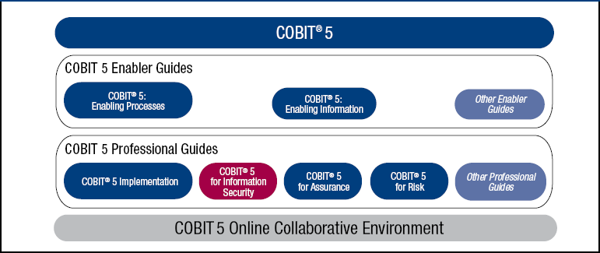
COBIT 5 Product Family
Source: COBIT® 5 for Information Security, figure 1. © 2012 ISACA® All rights reserved.
© 2012 ISACA. All rights reserved. 42
Notes:
This graphic illustrates the planned family–in the short term–for COBIT 5. The Framework is at the top. It is the basis upon which everything else is built.
It is supported by enabler guides–note that there is a process enabler guide, showing a continued presence of processes as key enablers.
The next level of support is professional guides, which will be very pragmatic, practical guidance on how to use and apply COBIT in the enterprise. COBIT for Information Security is the second of the practitioner guides–the Implementation guide is the other one that is currently available. COBIT for Risk and COBIT for Assurance are in development.
All this will then be supported by an online collaborative environment, that will enable customisation of COBIT for the enterprise’s needs and benchmarking.

Slide 43
COBIT 5 for Information Security
Extended view of COBIT5
Explains each component from info security perspective
© 2012 ISACA. All rights reserved. 43
Notes:
COBIT 5 for Information Security delivers an extended view of COBIT 5 that explains each component of COBIT 5 from an information security perspective. It is a view of information security governance and management that provides security professionals detailed guidance for using COBIT 5 as they establish, implement and maintain information security in the business policies, processes and structures of an enterprise.
Additional value for information security constituents will be created through additional explanations, activities, processes and recommendations.

Slide 44



What does it contain?
Guidance on drivers, benefits
Principles from infosec perspective
Enablers for support
Alignment with standards
© 2012 ISACA. All rights reserved. 44
Notes:
COBIT 5 for Information Security contains:
Guidance on the enterprise business drivers and benefits related to information security
How the COBIT 5 principles can be viewed and applied from an information security professionals’ perspective
How the COBIT 5 enablers can be used by information security professionals to support enterprise governance and management of information security arrangements
How COBIT 5 for Information Security guidance aligns with other information security standards

Slide 45
Drivers
The major drivers for the development of COBIT 5 for Information Security include:
The need to describe information security in an enterprise context
An increasing need for enterprises to:
Keep risk at acceptable levels.
Maintain availability to systems and services.
Comply with relevant laws and regulation.
The need to connect to and align with other major standards and frameworks
The need to link together all major ISACA research, frameworks and guidance
© 2012 ISACA. All rights reserved. 45

Slide 46
Benefits
Using COBIT 5 for Information Security can result in a number of benefits, including:
Reduced complexity and increased cost-effectiveness due to improved and easier integration of information security standards
Increased user satisfaction with information security arrangements and outcomes
Improved integration of information security in the enterprise
Informed risk decisions and risk awareness
Improved prevention, detection and recovery
Reduced impact of security incidents
Enhanced support for innovation and competitiveness
Improved management of costs related to the information security function
Better understanding of information security
© 2012 ISACA. All rights reserved. 46

Slide 47
Information Security Defined
ISACA defines information security as something that:
Ensures that within the enterprise, information is protected against disclosure to unauthorized users (confidentiality), improper modification (integrity) and non-access when required (availability).
© 2012 ISACA. All rights reserved. 47

Slide 48
Using COBIT 5 Enablers for Implementing Information Security
COBIT 5 for Information Security provides specific guidance related to all enablers
Information security policies, principles, and frameworks
Processes, including information security-specific details and activities
Information security-specific organisational structures
In terms of culture, ethics and behaviour, factors determining the success of information security governance and management
Information security-specific information types
Service capabilities required to provide information security functions to an enterprise
People, skills and competencies specific for information security
© 2012 ISACA. All rights reserved. 48

Slide 49
Enabler: Principles, Policies and Frameworks
Principles, policies and frameworks refer to the communication mechanisms put in place to convey the direction and instructions of the governing bodies and management, including:
Principles, policies and framework model
Information security principles
Information security policies
Adapting policies to the enterprises environment
Policy life cycle
© 2012 ISACA. All rights reserved. 49

Slide 50
Enabler: Principles, Policies and Frameworks (cont.)
Source: COBIT 5 for Information Security, figure 10. © 2012 ISACA® All rights reserved
© 2012 ISACA. All rights reserved. 50

Slide 51
Information Security Principles
Information security principles communicate the rules of the enterprise. These principles need to be:
Limited in number
Expressed in simple language
In 2010 ISACA, ISF and ISC² worked together to create 12 principles* that will help information security professionals add value to their organisations. The principles support 3 tasks:
Support the business.
Defend the business.
Promote responsible information security behaviour.
* Principles are covered in COBIT 5 for Information Security and can also be located at www.isaca.org/standards
© 2012 ISACA. All rights reserved. 51

Slide 52
Information Security Policies
Policies provide more detailed guidance on how to put principles into practice. Some enterprises may include policies such as:
Information security policy
Access control policy
Personnel information security policy
Incident management policy
Asset management policy
COBIT 5 for Information Security describes the following attributes of each policy:
Scope
Validity
Goals
© 2012 ISACA. All rights reserved. 52

Slide 53
Enabler: Processes
The COBIT 5 process reference model subdivides the IT-related practices and activities of the enterprise into two main areas—governance and management—with management further divided into domains of processes:
The Governance domain contains five governance processes; within each process, evaluate, direct and monitor (EDM) practices are defined.
The four Management domains are in line with the responsibility areas of plan, build, run and monitor (PBRM).
COBIT 5 for Information Security examines each of the processes from an information security perspective.
© 2012 ISACA. All rights reserved. 53

Slide 54
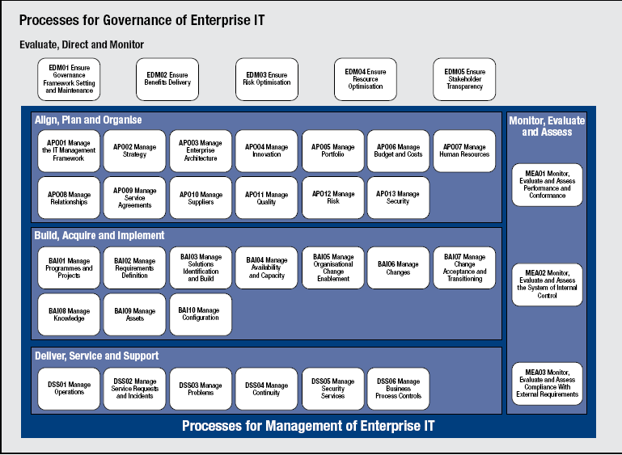
Enabler: Processes (cont.)
Source: COBIT 5 for Information Security, figure 7. © 2012 ISACA® All rights reserved
© 2012 ISACA. All rights reserved. 54

Slide 55
Enabler: Organisational Structures
COBIT 5 examines the organisational structures model from an information security perspective. It defines information security roles and structures and also examines accountability over information security, providing examples of specific roles and structures and what their mandate is, and also looks at potential paths for information security reporting and the different advantages and disadvantages of each possibility.
© 2012 ISACA. All rights reserved. 55

Slide 56
Enabler: Culture, Ethics and Behaviour
Examines the culture, ethics and behaviour model from an information security perspective providing detailed security specific examples of:
The Culture Life Cycle –measuring behaviours over time to benchmark the security culture –some behaviours may include:
Strength of passwords
Lack of approach to security
Adherence to change management practices
Leadership and Champions –need these people to set examples and help influence culture:
Risk managers
Security professionals
C-level executives
Desirable Behaviour –a number of behaviours have been identified that will help positively influence security culture:
Information security is practiced in daily operations.
Stakeholders are aware of how to respond to threats.
Executive management recognises the business value of security.
© 2012 ISACA. All rights reserved. 56

Slide 57
Enabler: Information
Information is not only the main subject of information security but is also a key enabler.
Information types are examined and reveal types of relevant security information which can include:
Information security strategy
Information security budget
Policies
Awareness material
Etc.
Information stakeholders as well as the information life cycle are also identified and detailed from a security perspective. Details specific to security such as information storage, sharing, use and disposal are all discussed.
© 2012 ISACA. All rights reserved. 57

Slide 58
Enabler: Services, Infrastructure and Applications
The services, infrastructure and applications model identifies the services capabilities that are required to provide information security and related functions to an enterprise. The following list contains examples of potential security-related services that could appear in a security service catalogue:
Provide a security architecture.
Provide security awareness.
Provide security assessments.
Provide adequate incident response.
Provide adequate protection against malware, external attacks and intrusion attempts.
Provide monitoring and alert services for security related events.
© 2012 ISACA. All rights reserved. 58

Slide 59
Enabler: People, Skills and Competencies
To effectively operate an information security function within an enterprise, individuals with appropriate knowledge and experience must exercise that function. Some typical security-related skills and competencies listed are:
Information security governance
Information risk management
Information security operations
COBIT 5 for Information Security defines the following attributes for each of the skills and competencies:
Skill definition
Goals
Related enablers
© 2012 ISACA. All rights reserved. 59

Slide 60
Chapter 2: Implementing Information Security Initiatives
Considering the enterprise information security context: COBIT 5 for Information Security advises that every enterprise needs to define and implement its own information security enablers depending on factors within the enterprise’s environment such as:
Ethics and culture relating to information security
Applicable laws, regulations and policies
Existing policies and practices
Information security capabilities and available resources
© 2012 ISACA. All rights reserved. 60

Slide 61
Chapter 2: Implementing Information Security Initiatives (cont.)
Additionally, the enterprise’s information security requirements need to be defined based on:
Business plan and strategic intentions
Management style
Information risk profile
Risk appetite
The approach for implementing information security initiatives will be different for every enterprise and the context needs to be understood to adapt COBIT 5 for Information Security effectively.
© 2012 ISACA. All rights reserved. 61

Slide 62
Chapter 2: Implementing Information Security Initiatives (cont.)
Other key areas of importance when implementing COBIT 5 for Information Security are:
Creating the appropriate environment
Recognising pain points and trigger events
Enabling change
Understanding that implementing information security practices is not a one time event but is a life cycle
© 2012 ISACA. All rights reserved. 62

Slide 63
Chapter 3: Using COBIT 5 for Information Security to Connect Other Frameworks, Models, Good Practices and Standards
COBIT 5 for Information Security aims to be an umbrella framework to connect to other information security frameworks, good practices and standards.
COBIT 5 for Information Security describes the pervasiveness of information security throughout the enterprise and provides an overarching framework of enablers, but the others can be helpful as well because they may elaborate on specific topics. Examples include:
Business Model for Information Security (BMIS)–ISACA
Standard of Good Practice for Information Security (ISF)
ISO/IEC 27000 Series
NIST SP 800-53a
PCI-DSS
© 2012 ISACA. All rights reserved. 63

Slide 64
Questions ???
© 2012 ISACA. All rights reserved. 64

